Slide 1

Predicting used car prices using machine Learning
Project Team:
Mazharuddin Mohammed
Manaswini Pedimalla
Jayanth Vodnala
Machine Learning Michael Zelenetz

Slide 2
Introduction
Predicting the price of a used car is a critical challenge in the automotive industry. Various factors, such as the car’s brand, model, age, mileage, fuel type, and transmission, significantly influence its price.
Understanding these factors and leveraging machine learning techniques to predict prices accurately can provide immense value to both buyers and sellers. Buyers can make informed decisions, and sellers can price their vehicles competitively.
This project explores the use of machine learning models to predict the prices of used cars based on a dataset containing over 9,500 entries with features such as car specifications, ownership history, and usage statistics. The primary objective is to develop a robust and scalable model that can generalize well across unseen data while achieving high accuracy.
The key goals of this project include:
• Identifying the most critical factors affecting used car prices.
• Experimenting with and optimizing various machine learning algorithms.
• Interpreting the model outputs to provide actionable insights.
• Recommending strategies for further improvement in prediction accuracy.

Slide 3
Dataset Description
The dataset used in this project contains detailed information on used cars, with 9,582 entries and 11 features. Each row represents a unique car listing, and the features include a mix of categorical and numerical attributes that describe the car’s specifications, condition, and pricing.
The following features are included in the dataset:
• Brand: The manufacturer of the car (e.g., Honda , Toyota , Maruti suzuki).
• Model: The specific model of the car (e.g., City, Innova, swift)
• Year: The year the car was manufactured.
• Age: The age of the car, calculated as the difference between the current year and the manufacturing year.
• Km driven: The total distance the car has been driven (in kilometers).
• Transmission: The type of transmission system (manual or automatic).
• Owner: The ownership history of the car (e.g , First, second, third).
• Fuel type: The type of fuel used ( e.g , Petrol, diesel, CNG).
• Posted date: The date when the car listing was posted.
• Addition info: Miscellaneous additional information provided by the seller.
• Ask price: The price at which the car is being listed for sale

Slide 4


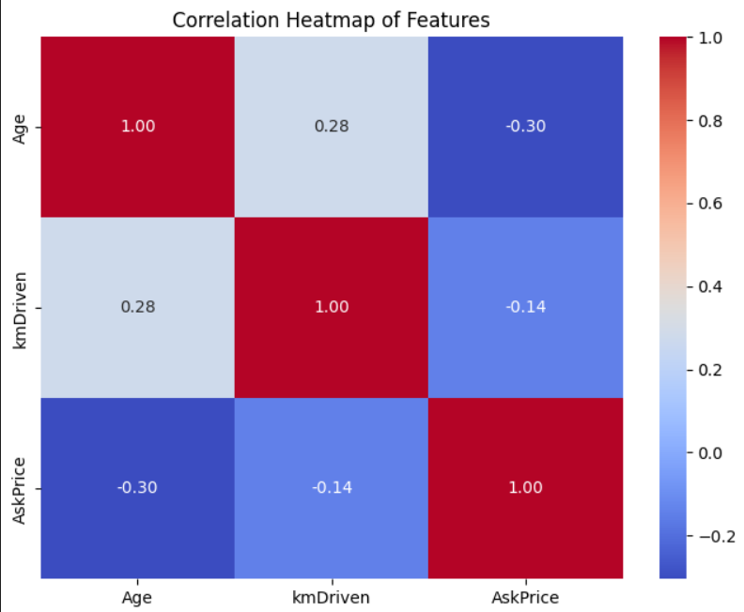
Data Preprocessing
Missing values in the km driven column were imputed using the median. ​
Categorical features were encoded using label encoding and one-hot encoding, depending on their nature. ​
A new feature, Age_ km Driven, was derived from the Age and Km Driven columns. ​
The target variable, ask price, was transformed using a logarithmic transformation to reduce skewness and improve model performance.​

Slide 5
Feature Engineering And Preprocessing
Feature engineering
• Derived feature- age: The age of the car was calculated as the difference between the year of posting (posted date) and the manufacturing year (year). This feature was found to be more predictive than year.
• Interaction term- age km driven: An interaction term between age and km driven was added to capture their combined influence on ask price.
Preprocessing Steps • Handling missing values: The km driven column contained some missing values. These were imputed using the median to preserve the central tendency of the data without introducing bias.
• Encoding categorical variables: Categorical features such as brand, model, transmission, fuel type, and owner were encoded into numerical values:
– Label encoding: used for transmission, owner, and fuel type.

Slide 6
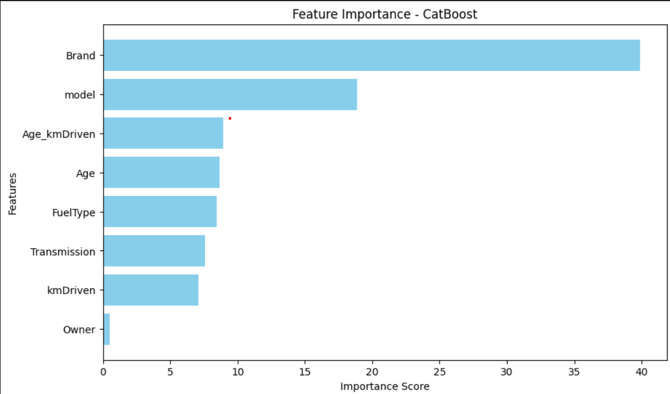
Final Dataset Characteristics
After preprocessing,
The final dataset consisted of the following:
• Number of features : 8 (including engineered features such as age and age km driven).
• Training dataset size: 7,665 rows.
• Testing dataset size: 1,917 rows.

Slide 7
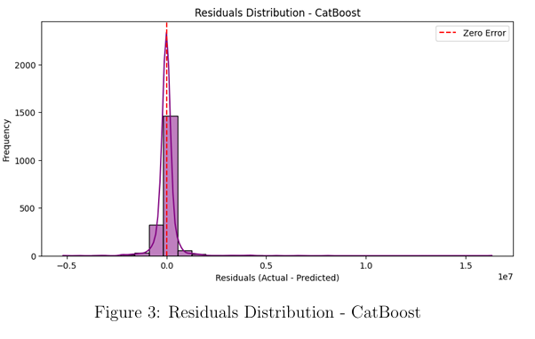
Visualization of pre-processed features
The residuals distribution after applying the cat boost model, which illustrates the effectiveness of the preprocessing steps.

Slide 8
Model Building And Evaluation
To predict the price of used cars, multiple machine learning models were trained and evaluated. This section details the models used, their training process, and performance metrics.
Baseline models
The following regression models were implemented as baselines:
• Linear regression: A simple model to establish a baseline. Despite its simplicity, the model was unable to capture complex relationships between features.
– Training MSE: 2,254,115,088,404.78
– Test MSE: 2,152,847,506,619.19
– Training R²: 0.1856 (accuracy: 18.56%)
– Test R²: 0.1969 (accuracy: 19.69%)
• Ridge and Lasso regression: Regularized regression models were applied, but their performance was similar to linear regression, indicating the need for more complex models.

Slide 9
Advanced Models
To improve the prediction performance, the following advanced models were implemented:
• XG boost: A gradient-boosted decision tree model that showed significant improvement over the baseline.
– Training MSE: 335,186,316,944.73
– Test MSE: 803,866,165,171.79
– Training R²: 0.8789 (accuracy: 87.89%)
– Test R²: 0.7001 (accuracy: 70.01%)
• Optimized XG boost: After hyperparameter tuning, the performance further improved.
– Best parameters: {learning rate: 0.2, max depth: 7, min child weight: 1, n estimators: 200, subsample: 0.8}
– Test MSE: 554,790,721,534.56
– Test R²: 0.7930 (accuracy: 79.30%)
• Light GBM: A gradient-boosting model with efficient training on large datasets.
– Training MSE: 348,015,503,594.21

Slide 10
– Test MSE: 675,157,840,372.63
– Training R²: 0.8743 (accuracy: 87.43%)
– Test R²: 0.7481 (accuracy: 74.81%)
• Cat Boost: A boosting model optimized for categorical data, which outperformed all previous models.
– Training MSE: 332,975,104,047.52
– Test MSE: 660,276,823,725.44
– Training r²: 0.8797 (accuracy: 87.97%)
– Test R²: 0.7537 (accuracy: 75.37%)
• Optimized Cat Boost: hyperparameter tuning significantly enhanced the performance.
– Best parameters: {depth: 7, iterations: 300, learning rate: 0.2, subsample: 1.0}
– Test MSE: 429,860,699,681.17
– Test R²: 0.8396 (accuracy: 83.96%)

Slide 11
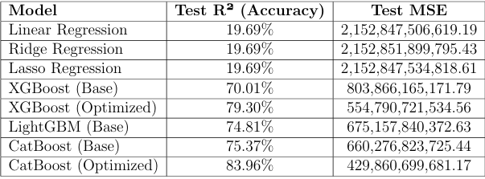
Performance Comparison
The table below summarizes the performance of different models evaluated during the project:

Slide 12
Challenges And Insights
During the course of this project, several challenges were encountered, each providing valuable insights into the nuances of building machine learning models for price prediction.
Challenges faced
• Data preprocessing:
– Inconsistent data formats: The km driven and ask price columns were in inconsistent formats with special characters, requiring extensive preprocessing to standardize them.
– Missing values: The km driven feature had missing values, which were imputed with the median to minimize distortion.
• Feature engineering:
– High cardinality features: features like brand and model had high cardinality, which made one-hot encoding computationally expensive. Label encoding was used instead
– Weak correlations: some features such as km driven showed weak correlation with the target variable, requiring experimentation with interaction terms to capture nonlinear relationships.

Slide 13
• Model selection and optimization:
– Overfitting: Advanced models like XG Boost and Cat Boost initially showed signs of overfitting, which was mitigated through hyperparameter tuning and cross-validation.
– Hyperparameter tuning complexity: The search for optimal hyperparameters, especially for gradient boosting models, was computationally expensive and required extensive resources.
• Evaluation metrics:
– Interpreting MSE and R²: Balancing between minimizing mean squared error (MSE) and maximizing R² was challenging, particularly in models where slight improvements in R² resulted in substantial computational costs.

Slide 14
Insights Gained
Feature importance: The cat boost model revealed that brand and model were the most significant features, highlighting the importance of categorical data in price prediction.
• Interaction terms: Adding interaction terms like age km driven improved the model’s performance, demonstrating the utility of feature engineering in capturing complex relationships.
• Logarithmic Transformation: Transforming the target variable ask price reduced skewness and stabilized variance, leading to improved model performance across all algorithms.
• Model comparison: Cat boost outperformed other models after hyperparameter tuning, achieving an R² of 83.96%, making it the most suitable model for this task.

Slide 15
Future Work
• External data integration: Including external datasets such as market trends, location-based demand, and car condition ratings could improve the model’s predictive power.
• Advanced techniques: exploring ensemble techniques like stacking or blending could potentially enhance performance further.
• Deep learning models: experimenting with deep learning architectures such as neural networks may provide additional insights, particularly for capturing non linear relationships in the data.

Slide 16
Conclusion
• Model Performance: After experimenting with several models, the optimized cat boost model emerged as the most effective for this dataset, achieving an R² of 83.96% (accuracy: 83.96%) and a test MSE of 429,860,699,681.17. Its ability to handle categorical data and its efficient training process made it the ideal choice.
• Feature Importance: The brand and model features were the most influential in determining the price of a used car, emphasizing the critical role of categorical features in this domain.
• Impact of preprocessing: Key preprocessing steps, including handling missing values, encoding categorical features, and applying logarithmic transformations, significantly improved model performance.
• Challenges Addressed: Issues such as overfitting, high cardinality in categorical features, and weak correlations were effectively mitigated through feature engineering, hyperparameter tuning, and advanced model selection.

Slide 17
THANK YOU

